Slide 1
“Emergency response techniques by measuring heart rate and blood pressure via Smartphone application”
Supervised by:
Dr. Brian Debrit
Presented by:
Vimal Jaswal - B00122875
MIOT - H6022
Technological University Dublin, Blanchardstown

Slide 2
Introduction and Background
Heart disease and Blood Pressure is a common issue that causes hypertension as well. COVID-19 also impacted the health services for this kind of non-communicable diseases[1]
The improvement of health and wellbeing progressively depend on remote Smartphone applications and organized sensors and actuators. [2]
The idea is to develop an algorithm and application paradigm that can help patients with the necessary treatment based on the heart rate and blood pressure data collected by Smartphone. The experiment is to collect data from a patient via Smartphone and send it on to cloud database service and then transform that into information required by the user or doctor to take necessary actions and set alerts.

Slide 3
Problem statement/objectives
There is a mandatory requirement of the doctor to assist the patient with diet and prescription in case of a disease even if patient activity is monitored. There is still a requirement of such applications that can help improve the emergency support in case of need by the patients. Another issue is that there is less number of doctors available as compared to patients. The situation became worse in case of natural disaster or pandemic.
Research Question
"How can we improve emergency medical services by determining medical parameters like blood pressure and pulse rate via Smartphone application?"
Objectives
The main objective is to look at various scenarios that can be helpful in resolving the problem of monitoring patients from remote location. Secondly, to look at the current scenarios already present and how these can be improved further in case of different emergency situations.
The Final objective of this research is to develop a user friendly and efficient Smartphone application to monitor patients without the need of frequently visiting doctors or hospitals and without use of extra medical devices.
The individuals will receive an answer about how will the mobile application developed via this research will help to reduce response time of medical professionals and emergency services along with helping individuals to control and warn them about their medical condition which will motivate individuals to live a healthy life and take preventive measures which in turn will decrease the risk from disease caused due to tension of unavailability of medical service and save lives.

Slide 4
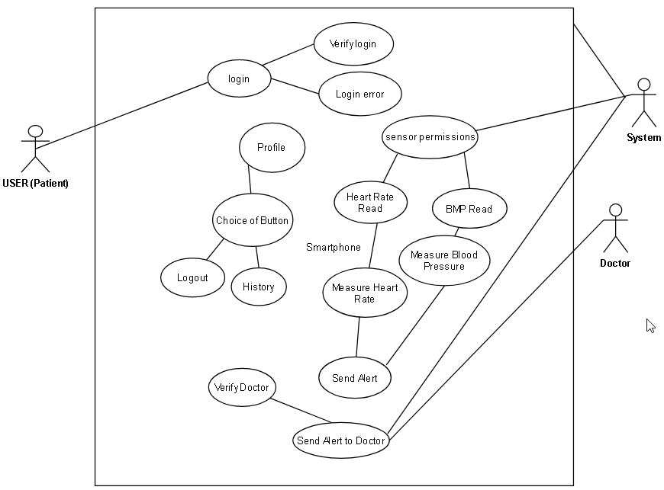
UML Diagram for Smartphone application

Slide 5
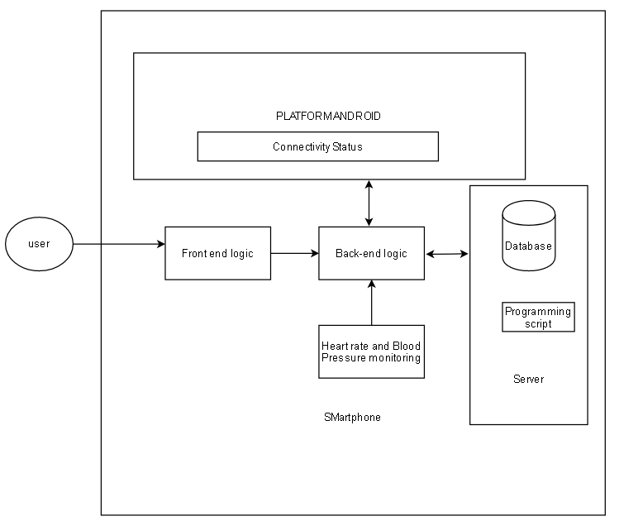
Architecture for Smartphone application

Slide 6
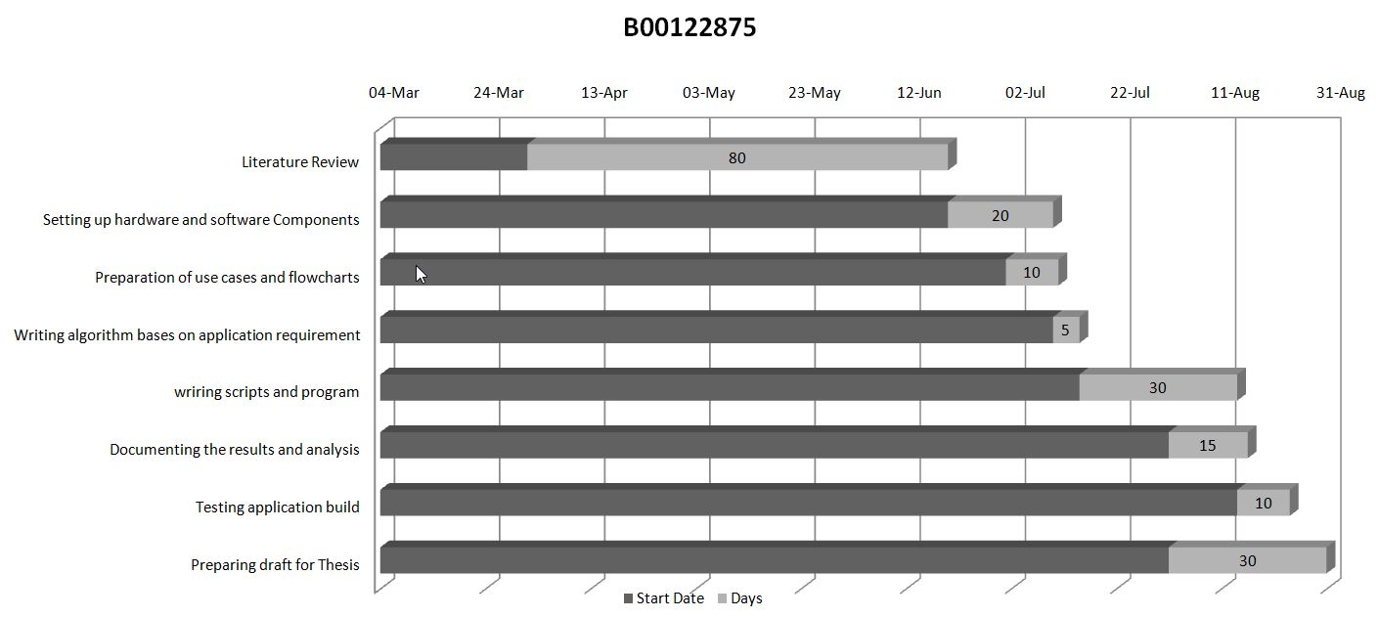
Project Plan

Slide 7
References
[1] Who.int. 2020. COVID-19 Significantly Impacts Health Services For Noncommunicable Diseases. [online] Available at: <https://www.who.int/news-room/detail/01-06-2020-covid-19-significantly-impacts-health-services-for-noncommunicable-diseases> [Accessed 19 June 2020].
[2] Higgins, J.P., 2016. Smartphone applications for patients' health and fitness. The American journal of medicine, 129(1), pp.11-19.

Slide 8
Thank You…

